Slide 1

TWITTER sentiment analysis: Climate Change
Sairashmika Jammi
DATA 606 Capstone Project

Slide 2

RECAP

Slide 3
Methodology
Extract Data
Clean and Transform Data
Create Bag of Words and TF-IDF Vectors
Train classification model for both Bag of Words and TF-IDF
Accuracy

Slide 4
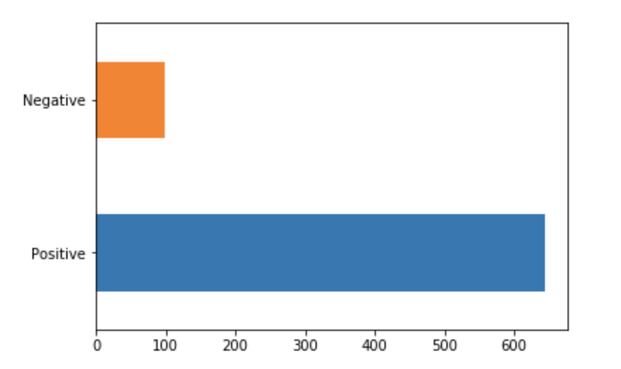

Slide 5
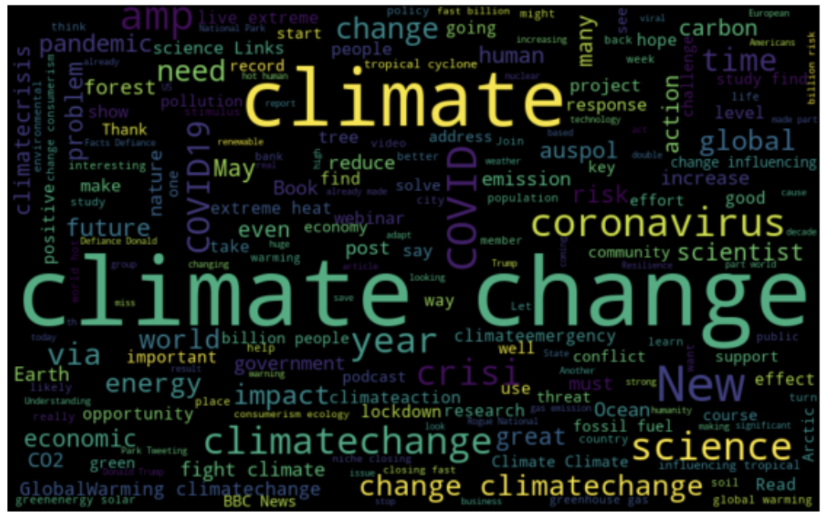
Negative Tweets

Slide 6
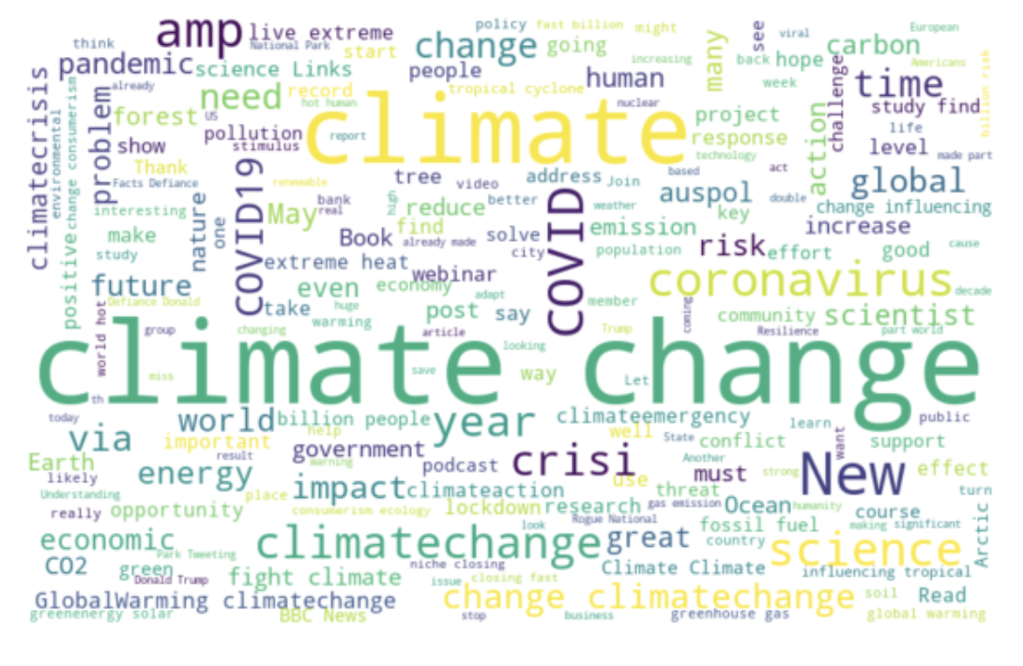
Positive Tweets

Slide 7
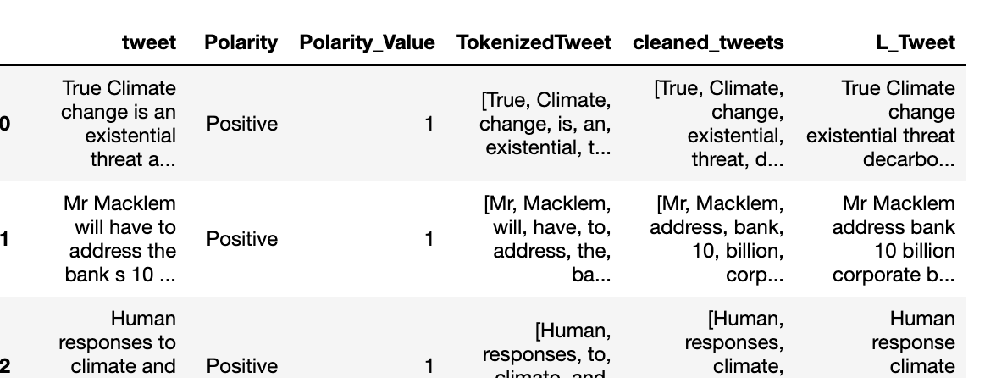
Data Cleaning and Transforming

Slide 8
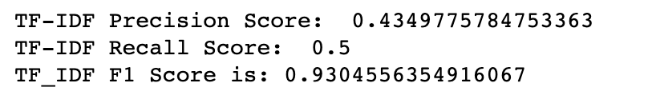
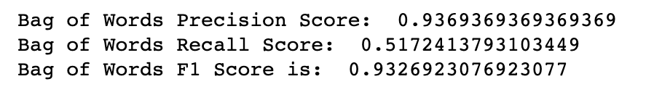
Accuracy
Notes:
Precision
Percentage of predictions that were correct True Positives / (True Positives + False Positives)
Recall
The ability of a classifier to find all positive instances True Positives/(True Positives +False Negatives)
f1-score
The weighted harmonic mean of precision and recall such that the best score is 1.0 and the worst is 0.0.

Slide 9

Setbacks

Slide 10
Next Steps

Slide 11
Thank you!
Please feel free to contact me at jammi1@umbc.edu for any questions or concerns.
Feedback is always appreciated!

